Slide 1

MACHINE INTELLIGENCE
Dr. N MEHALA
Department of Computer Science and Engineering

Slide 2

MACHINE INTELLIGENCE
Module 4 [Unsupervised Learning]
Dr. N MEHALA
Department of Computer Science and Engineering

Slide 3
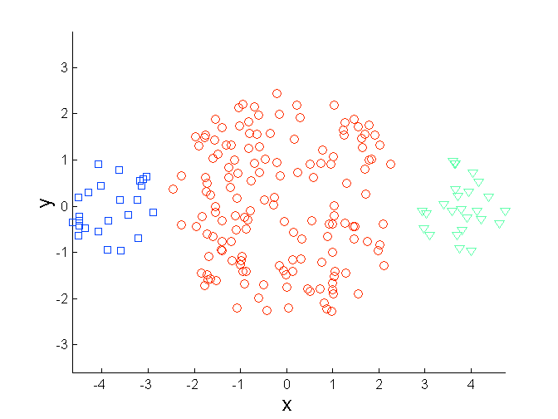
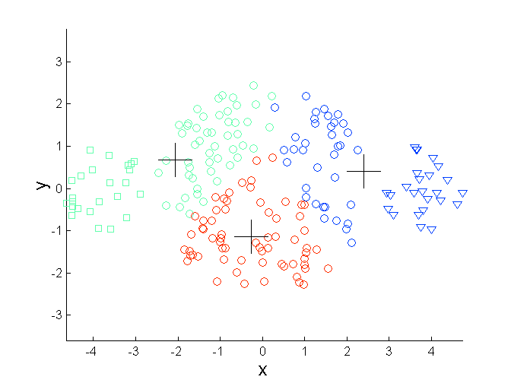
MACHINE INTELLIGENCE
K-Means Clustering: Limitations
Limitations of K-means: Differing Sizes
Original Points
K-means (3 Clusters)

Slide 4
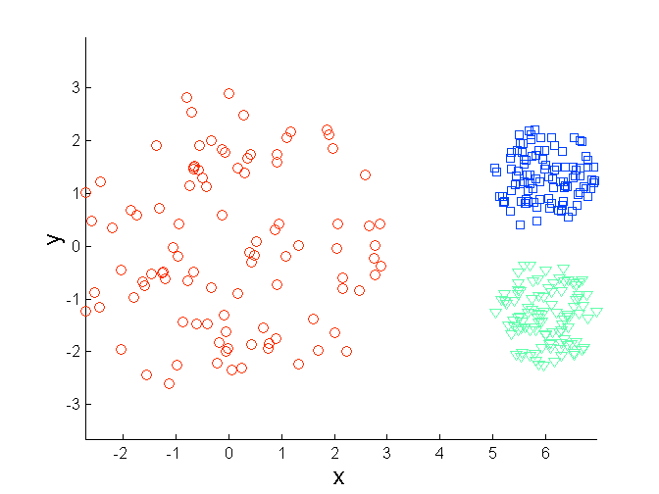
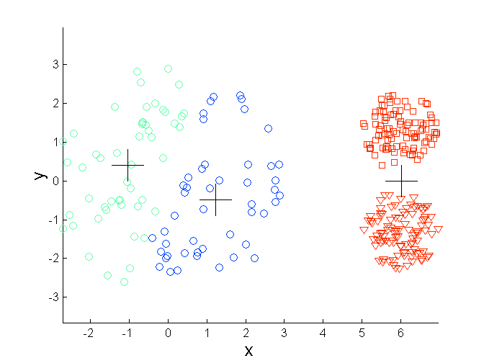
MACHINE INTELLIGENCE
K-Means Clustering: Limitations
Limitations of K-means: Differing Density
Original Points
K-means (3 Clusters)

Slide 5
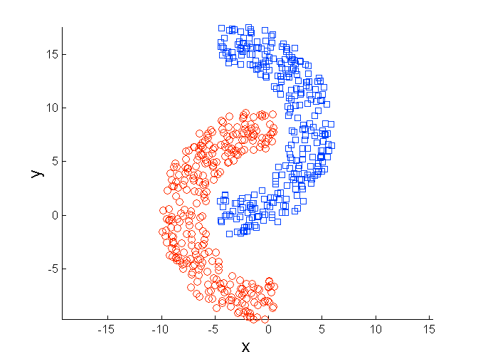
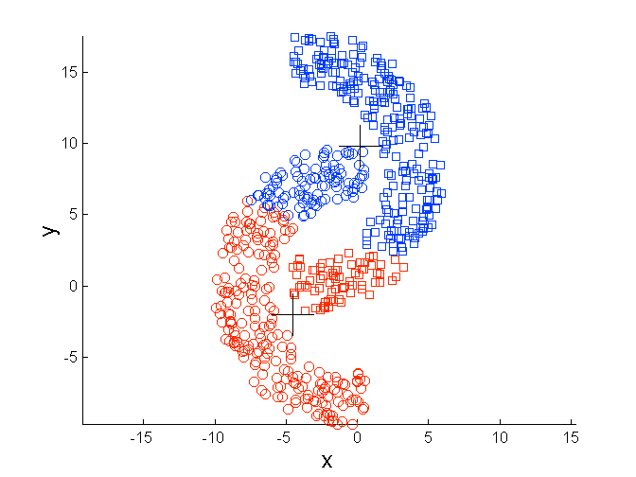
MACHINE INTELLIGENCE
K-Means Clustering: Limitations
Limitations of K-means: Non-globular Shapes
Original Points
K-means (2 Clusters)

Slide 6
MACHINE INTELLIGENCE
K-Means Clustering: Limitations
Importance of Choosing Initial Centroids

Slide 7
MACHINE INTELLIGENCE
K-Means Clustering: Limitations
Importance of Choosing Initial Centroids

Slide 8
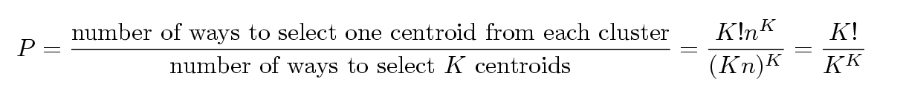
MACHINE INTELLIGENCE
K-Means Clustering: Limitations
Problems with Selecting Initial Points
If there are K ‘real’ clusters then the chance of selecting one centroid from each cluster is small.
Chance is relatively small when K is large
If clusters are the same size, n, then
For example, if K = 10, then probability = 10!/10¹⁰ = 0.00036
Sometimes the initial centroids will readjust themselves in ‘right’ way, and sometimes they don’t

Slide 9
MACHINE INTELLIGENCE
Solutions to Initial Centroids Problem
Multiple runs
Helps, but probability is not on our side
Sample and use hierarchical clustering to determine initial centroids
Select more than k initial centroids and then select among these initial centroids
Select most widely separated
Postprocessing
Generate a larger number of clusters and then perform a hierarchical clustering
Bisecting K-means
Not as susceptible to initialization issues

Slide 10
MACHINE INTELLIGENCE
Bisecting K-Means Clustering Algorithm
To overcome the problem of poor clusters because of k-means getting caught in a local minimum
Variant of K-means that can produce a partitional or a hierarchical clustering
Instead of partitioning the data set into K clusters in each iteration, bisecting k-means algorithm splits one cluster into two sub clusters at each bisecting step (by using k-means) until k clusters are obtained.
Hybrid approach between Divisive Hierarchical Clustering (top down clustering) and K-means Clustering.
Note: A local minimum means that the result is good but not necessarily the best possible. A global minimum is the best possible

Slide 11
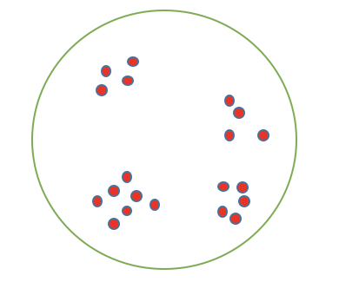
MACHINE INTELLIGENCE
Bisecting K-Means Clustering Algorithm
How it Works?
Step1: Set K to define the number of cluster
Step2: Set all data as a single cluster

Slide 12
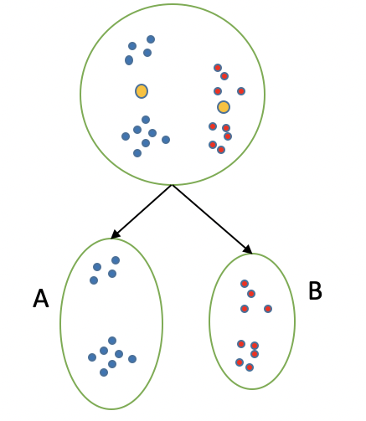
MACHINE INTELLIGENCE
Bisecting K-Means Clustering Algorithm
How it Works?
Step1: Set K to define the number of cluster
Step2: Set all data as a single cluster
Step3: Use K-means with K=2 to split the cluster

Slide 13
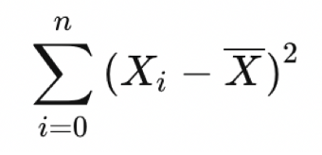
MACHINE INTELLIGENCE
Bisecting K-Means Clustering Algorithm
How it Works?
Step1: Set K to define the number of cluster
Step2: Set all data as a single cluster
Step3: Use K-means with K=2 to split the cluster
Step4: Measure the distance for each intra cluster
- Sum of square Distance
Step5: Select the cluster that have the largest distance and split to 2 cluster using K-means

Slide 14
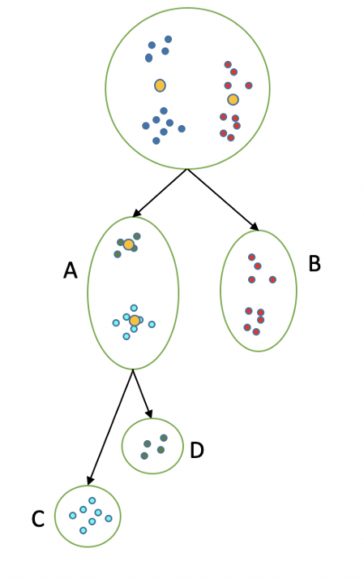
MACHINE INTELLIGENCE
Bisecting K-Means Clustering Algorithm
How it Works?
Step1: Set K to define the number of cluster
Step2: Set all data as a single cluster
Step3: Use K-means with K=2 to split the cluster
Step4: Measure the distance for each intra cluster
- Sum of square Distance
Step5: Select the cluster that have the largest distance and split to 2 cluster using K-means

Slide 15
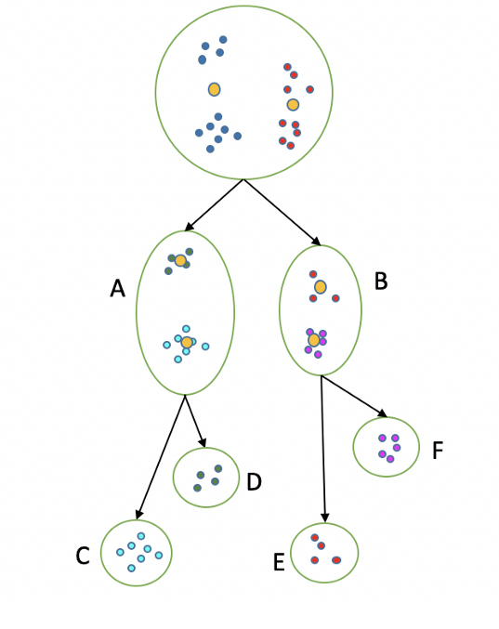
MACHINE INTELLIGENCE
Bisecting K-Means Clustering Algorithm
How it Works?
Step1: Set K to define the number of cluster
Step2: Set all data as a single cluster
Step3: Use K-means with K=2 to split the cluster
Step4: Measure the distance for each intra cluster
- Sum of square Distance
Step5: Select the cluster that have the largest distance and split to 2 cluster using K-means
Step6: Repeat step 3–5 until the number of leaf cluster = K.

Slide 16
MACHINE INTELLIGENCE
Bisecting K-Means Clustering Algorithm

Slide 17
MACHINE INTELLIGENCE
Advantage of Bisecting K-Means over K-Means
Bisecting k-means is more efficient when K is large.
Bisecting k-means produce clusters of similar sizes, while k-means is known to produce clusters of widely different sizes.
Notes:
For the kmeans algorithm, the computation involves every data point of the data set and k centroids. On the other hand, in each Bisecting step of Bisecting k-means, only the data points of one cluster and two centroids are involved in the computation. Thus, the computation time is reduced.

Slide 18
MACHINE INTELLIGENCE
Evaluating K-means Clusters
Most common measure is Sum of Squared Error (SSE)
For each point, the error is the distance to the nearest cluster.
Calculate error of each data point, i.e. its Euclidean distance to the closest centroid (mean) and then compute the total sum of the squared errors.
To get SSE, we square these errors and sum them.
x is a data point in cluster C_{i} and m_{i} is the representative point for cluster C_{i}
can show that m_{i} corresponds to the center (mean) of the cluster

Slide 19
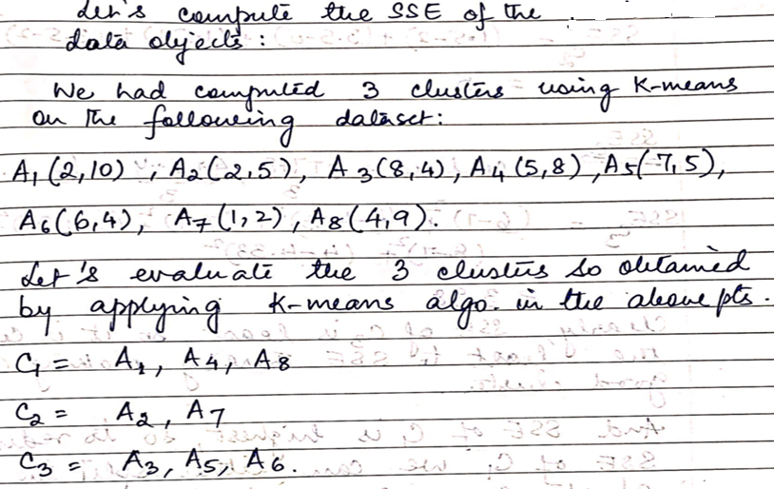
MACHINE INTELLIGENCE
EXAMPLE

Slide 20
MACHINE INTELLIGENCE
Example

Slide 21
MACHINE INTELLIGENCE
Example

Slide 22
MACHINE INTELLIGENCE
How to choose K?
1. Use another clustering method, like EM.
2. Run algorithm on data with several different values of K.
3. Use the prior knowledge about the characteristics of the problem.

Slide 23
MACHINE INTELLIGENCE
How to choose K?

Slide 24
MACHINE INTELLIGENCE
How to choose K?

Slide 25
MACHINE INTELLIGENCE
K-means as an optimization problem
Given an objective function “ minimize total SSE” is an optimization problem.
For solving this, we need to find the global optimum.
(explore all possible ways to get clusters and then choose the set of clusters that minimizes the objective function).
One technique for doing so is “Gradient Descent”:
Pick an initial solution
Repeat:
Compute the change to the solution that best optimizes the objective function and update the solution.

Slide 26
MACHINE INTELLIGENCE
Example

Slide 27
MACHINE INTELLIGENCE
Advantage of Bisecting K-Means over K-Means

Slide 28
MACHINE INTELLIGENCE
Advantage of Bisecting K-Means over K-Means

Slide 29
MACHINE INTELLIGENCE
Summary
K-Means Issues
Bisecting K-Means Clustering

Slide 30
MACHINE INTELLIGENCE
Similarity and Dissimilarity
More important – used in clustering, some classification, anomaly detection.
Similarity
Numerical measure of how alike two data objects are.
Is higher when objects are more alike.
Often falls in the range [0,1]
Dissimilarity
Numerical measure of how different are two data objects
Lower when objects are more alike
Minimum dissimilarity is often 0
Upper limit varies
Proximity refers to a similarity or dissimilarity

Slide 31
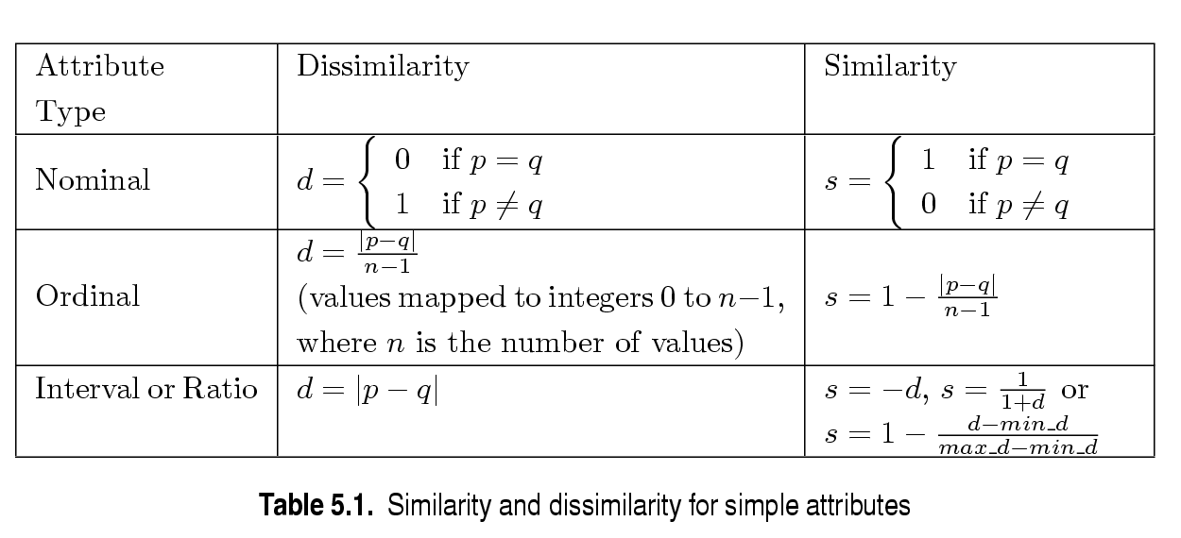
MACHINE INTELLIGENCE
Similarity/Dissimilarity for Objects with Single Attribute
p and q are the attribute values for two data objects.

Slide 32
MACHINE INTELLIGENCE
Dissimilarities between Data Objects with multiple Numeric attributes
For ordinal attributes : Need to normalize the attribute ranks.

Slide 33
MACHINE INTELLIGENCE
Dissimilarities between Data Objects with multiple Numeric attributes
Euclidean Distance
Where n is the number of dimensions and p_{k} and q_{k} are, respectively, the k^{th} attributes of data objects p and q.
Standardization is necessary, if scales differ.

Slide 34
MACHINE INTELLIGENCE
Euclidean Distance
Distance Matrix

Slide 35
MACHINE INTELLIGENCE
Minkowski Distance
Minkowski Distance is a generalization of Euclidean Distance. Given two objects p and q
Where r is a parameter, n is the number of dimensions and p_{k} and q_{k} are, respectively, the kth attributes of data objects p and q.

Slide 36
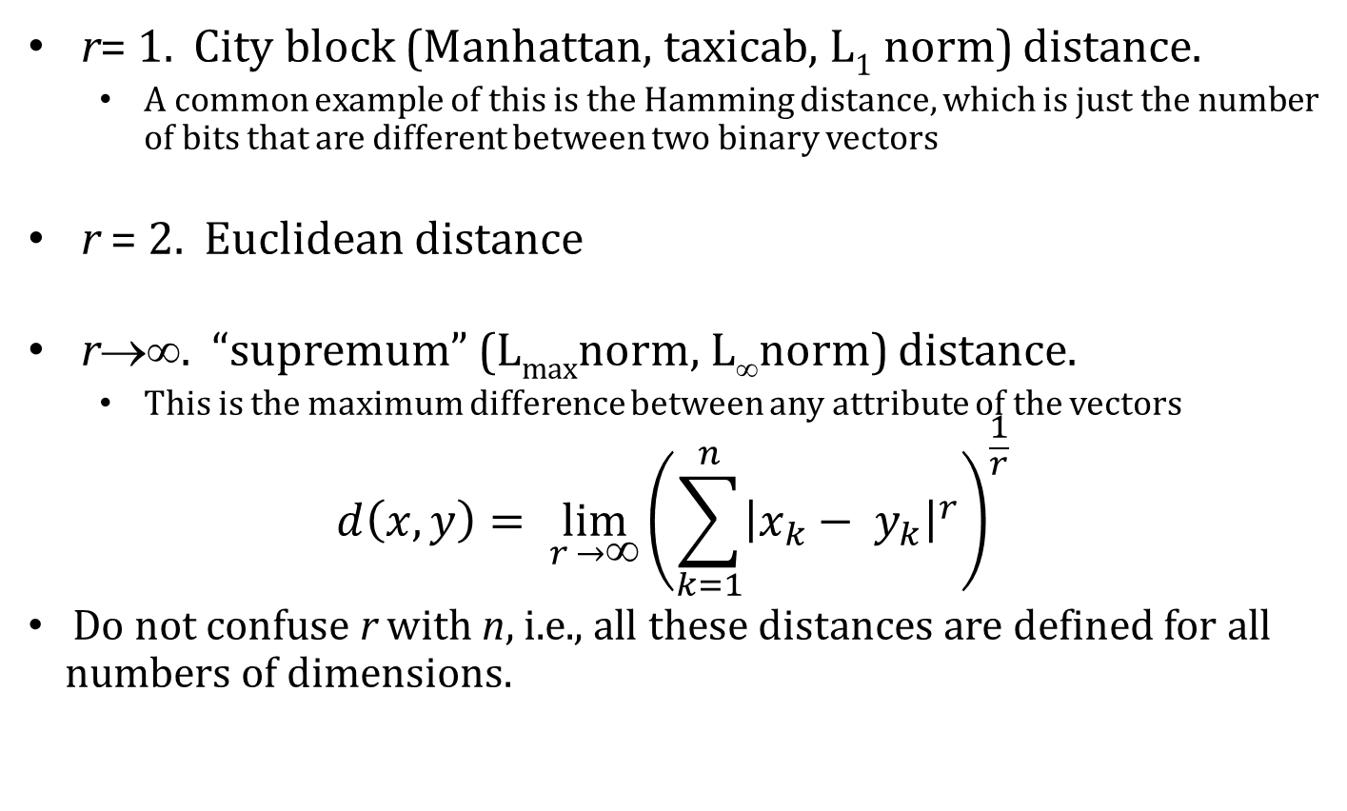
Minkowski Distance: Examples
MACHINE INTELLIGENCE

Slide 37
MACHINE INTELLIGENCE
Minkowski Distance
Distance Matrix

Slide 38
MACHINE INTELLIGENCE
Common Properties of a Distance
Distances, such as the Euclidean distance, have some well known properties.
d(p, q) ≥ 0 for all p and q and d(p, q) = 0 only if p = q. (Positive definiteness)
d(p, q) = d(q, p) for all p and q. (Symmetry)
d(p, r) ≤ d(p, q) + d(q, r) for all points p, q, and r. (Triangle Inequality)
where d(p, q) is the distance (dissimilarity) between points (data objects), p and q.
A distance that satisfies all these properties is a metric

Slide 39
MACHINE INTELLIGENCE
Common Properties of a Similarity
Similarities, also have some well known properties.
s(p, q) = 1 (or maximum similarity) only if p = q.
s(p, q) = s(q, p) for all p and q. (Symmetry)
where s(p, q) is the similarity between points (data objects), p and q.

Slide 40
MACHINE INTELLIGENCE
Similarity Between Binary Vectors
Common situation is that objects, p and q, have only binary attributes
Compute similarities using the following quantities
M₀₁ = the number of attributes where p was 0 and q was 1
M₁₀ = the number of attributes where p was 1 and q was 0
M₀₀ = the number of attributes where p was 0 and q was 0
M₁₁ = the number of attributes where p was 1 and q was 1
Simple Matching and Jaccard Coefficients
SMC = number of matches / number of attributes
= (M₁₁ + M₀₀) / (M₀₁ + M₁₀ + M₁₁ + M₀₀)
J = number of 11 matches / number of not-both-zero attributes values
= (M₁₁) / (M₀₁ + M₁₀ + M₁₁)

Slide 41
MACHINE INTELLIGENCE
SMC versus Jaccard: Example
p = 1 0 0 0 0 0 0 0 0 0
q = 0 0 0 0 0 0 1 0 0 1
M₀₁ = 2 (the number of attributes where p was 0 and q was 1)
M₁₀ = 1 (the number of attributes where p was 1 and q was 0)
M₀₀ = 7 (the number of attributes where p was 0 and q was 0)
M₁₁ = 0 (the number of attributes where p was 1 and q was 1)
SMC = (M₁₁ + M₀₀)/(M₀₁ + M₁₀ + M₁₁ + M₀₀) = (0+7) / (2+1+0+7) = 0.7
J = (M₁₁) / (M₀₁ + M₁₀ + M₁₁) = 0 / (2 + 1 + 0) = 0

Slide 42
MACHINE INTELLIGENCE
SMC & JC
SMC - Counts both presences and absences equally. Used for objects with symmetric binary attributes.
Can be used to find students who answered similarly in a test – true/false questions
JC is used to handle objects with assymetric binary attributes.
Ex: In a TDB:
No. of products not purchased is far more than purchased
SMC would say all transactions are very similar.
Use JC

Slide 43
MACHINE INTELLIGENCE
Cosine Similarity
If d₁ and d₂ are two document vectors, then
cos( d₁, d₂ ) = (d₁ • d₂) / ||d₁|| ||d₂|| ,
where • indicates vector dot product and || d || is the length of vector d.
Example:
d₁ = 3 2 0 5 0 0 0 2 0 0
d₂ = 1 0 0 0 0 0 0 1 0 2
d₁ • d₂= 3*1 + 2*0 + 0*0 + 5*0 + 0*0 + 0*0 + 0*0 + 2*1 + 0*0 + 0*2 = 5
||d₁|| = (3*3+2*2+0*0+5*5+0*0+0*0+0*0+2*2+0*0+0*0)^{0.5} = (42) ^{0.5} = 6.481
||d₂|| = (1*1+0*0+0*0+0*0+0*0+0*0+0*0+1*1+0*0+2*2) ^{0.5} = (6) ^{0.5} = 2.245
cos( d₁, d₂ ) = .3150
Cos(x,y) = 0 indicates both are dissimilar
Cos(x,y) = 1 indicates both are similar

Slide 44
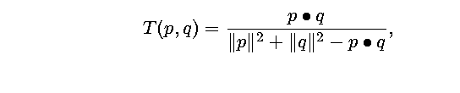
MACHINE INTELLIGENCE
Extended Jaccard Coefficient (Tanimoto)
Variation of JC
Used for document data
Reduces to Jaccard for binary attributes

Slide 45
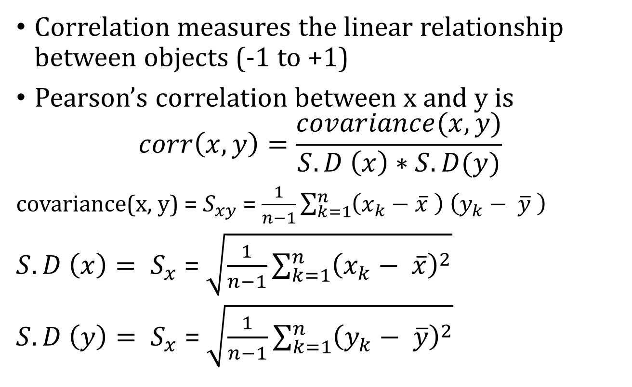
MACHINE INTELLIGENCE
Correlation

Slide 46
MACHINE INTELLIGENCE
Pearson’s Correlation
If correlation between two variables x and y is -1, they are negatively correlated.
If one increases, the other decreases and vice versa.
If correlation between two variables x and y is +1, they are positively correlated.
Either both increase or both decrease.

Slide 47
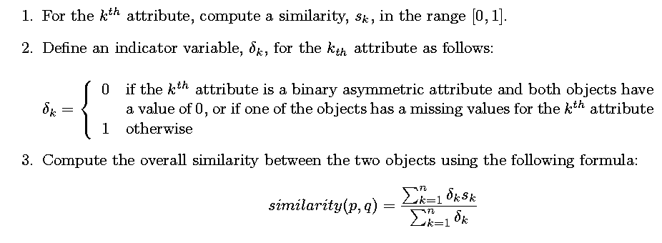
MACHINE INTELLIGENCE
General Approach for Combining Similarities
Sometimes attributes are of many different types, but an overall similarity is needed.

Slide 48
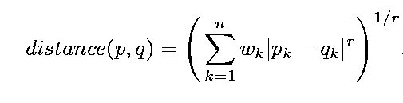
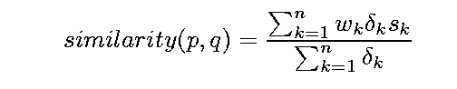
MACHINE INTELLIGENCE
Using Weights to Combine Similarities
May not want to treat all attributes the same.
Use weights w_{k} which are between 0 and 1 and sum to 1.

Slide 49
MACHINE INTELLIGENCE
Summary
K-Means Issues
Bisecting K-Means Clustering

Slide 50
MACHINE INTELLIGENCE
Resources
http://www2.ift.ulaval.ca/~chaib/IFT-4102-7025/public_html/Fichiers/Machine_Learning_in_Action.pdf
http://wwwusers.cs.umn.edu/~kumar/dmbook/.
ftp://ftp.aw.com/cseng/authors/tan
http://web.ccsu.edu/datamining/resources.html

Slide 51
THANK YOU
Dr. N MEHALA
Department of Computer Science and Engineering
mehala@pes.edu

